Slide 1
Functional Programming design patterns with real world example
By: Aryan Ebrahimpour
Heavily inspired by Scott Wlaschin

Slide 2





Table of Contents
Computation and Languages
Functional Design Patterns
Real World Example
References

Slide 3
Computation and Languages
Lets see some about programming languages and history

Slide 4
TOC :: Computation and Languages
What is computation?
OOP vs FP

Slide 5
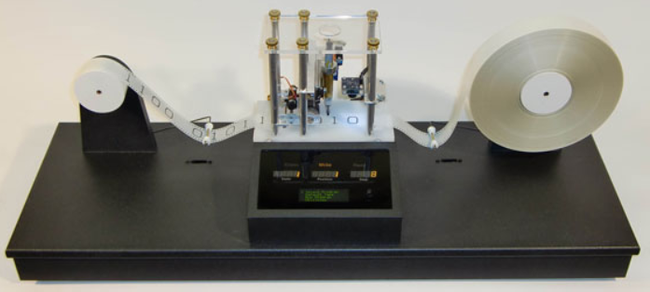
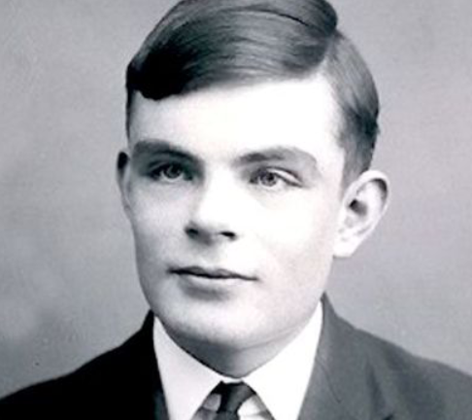
What is computation? (1934) And what does it mean to compute something?
An Imperative machine
Princeton
Powerful Machine for Computation
Alan Turing
Notes:
1934 ~ 1313
Finish:
Imperative: Do this, do this, read from tape write from tape.
Different types of Turing machine.
WW2, Enigma Machine

Slide 6
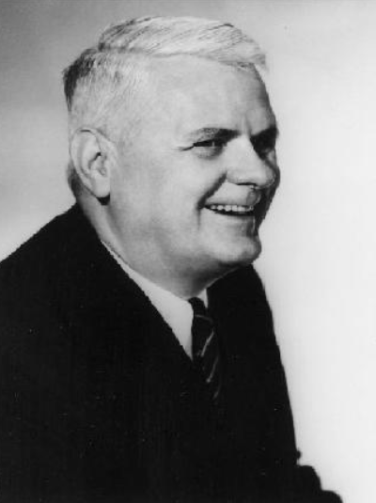
What is computation? (1934) And what does it mean to compute something?
T = λx . λy . x
F = λx . λy . y
and = λa . λb . a b F
and T T // result: T
and F T // result: F
and T F // result: F
var T = x => y => x
var F = x => y => y
var and = a => b => a(b)(F)
Alonzo Church
Close to Math and Logic, declarative expressions
Princeton
Powerful Machine for Computation (But powerful as Turing machines?)
Hint: Yes, anything you can do with one, you can do with the other
Notes:
1920 ~ 1299
Intro:
1920: Project involving Curry and Church. New foundation on math based on funcs.
FP came to existence 10 years before first computer.
Finish:
Church was Professor of Turing. Working separately.

Slide 7

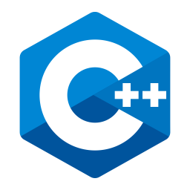














What is computation? (1934) And what does it mean to compute something?
Same Power, but they gave rise to different type of PLs
Imperative
They might added functional features overtime
Declarative → FP
They might added some imperative workflows overtime
Notes:
Scala → Apache Spark

Slide 8
Object Oriented vs Functional
OOP
FP
You say “do this, do this, then this”
Mutable Data / Impure Methods
Side-effects all over the place
Loops to iterate
Values and functions are different to the eyes of the programmer
You declare what you want
Immutable Data / Pure Functions
No/Controlled side-effects
Recursions to iterate
Values and Functions are defined in the same way (called first-class)

Slide 9
Declarative Example
Example of finding right triangle sides in a declarative way
let rightTriangles = [ (a,b,c) | c <- [1..10],
b <- [1..c],
a <- [1..b],
a^2 + b^2 == c^2]
Notes:
System.Diagnostics.Contracts

Slide 10
Pure Example
Example of a Pure function in C#
int Multiply(int a, int b) => a * b;
Notes:
System.Diagnostics.Contracts

Slide 11
Functional Design Patterns

Slide 12
OO Patterns
FP equvalient
Single Responsibility Principle
Open/Closed Principle
Dependency Injection Principle
Interface Segregation Principle
Factory Pattern
Strategy Pattern
Decorator Pattern
Visitor Pattern
Functions
Functions
Functions, also
Functions? Yes.
You’ll be assimilated!
LOL Functions
That’s it! Functions
Resistance is futile!
Seriously, FP patterns are different!
Notes:
Transfer knowledge from OO to FP

Slide 13
TOC :: Functional Programming Design Patterns
Core Principles of FP design
Functions, Partial Application, types, Composition
Functors
Applicatives
Monads

Slide 14
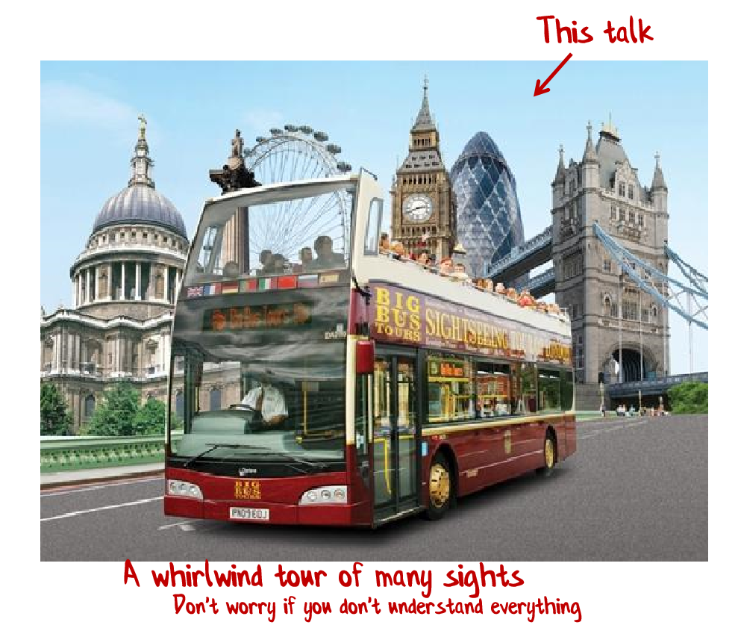
Notes:
Computational Expressions
Flexible types

Slide 15
(Some) Core principles of FP
Important to understand

Slide 16
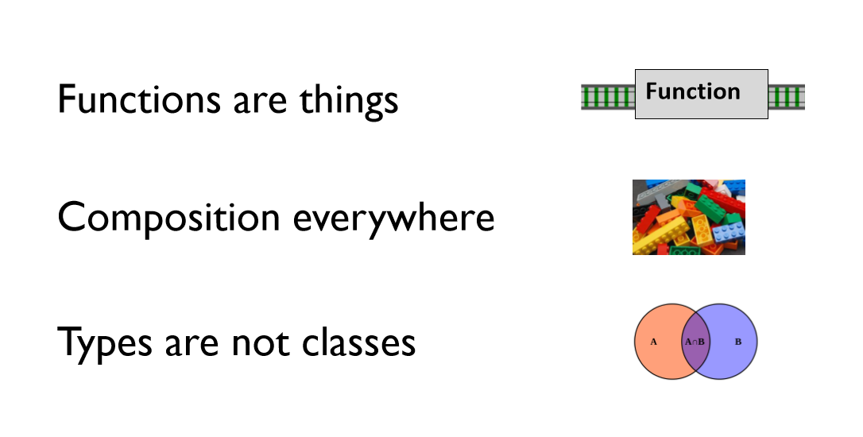
Core principles

Slide 17
Core Principle:
Functions are things (First-class)

Slide 18
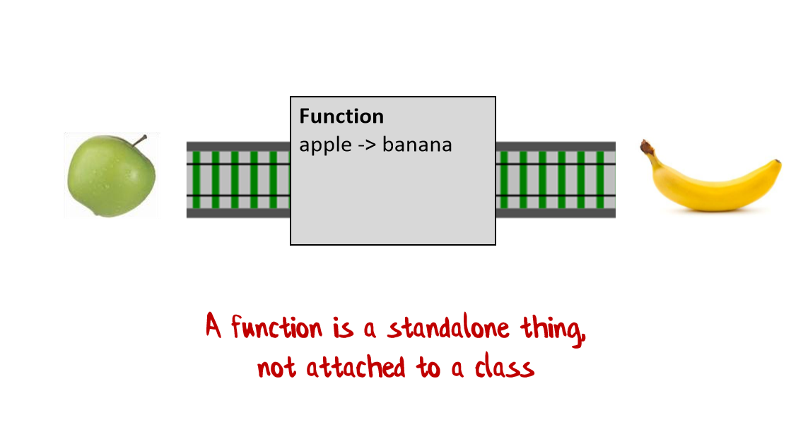
Functions are things!

Slide 19
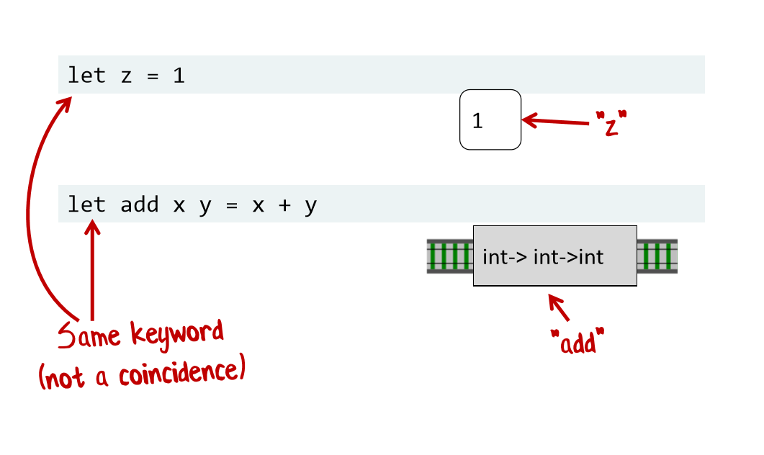
Functions are things!

Slide 20
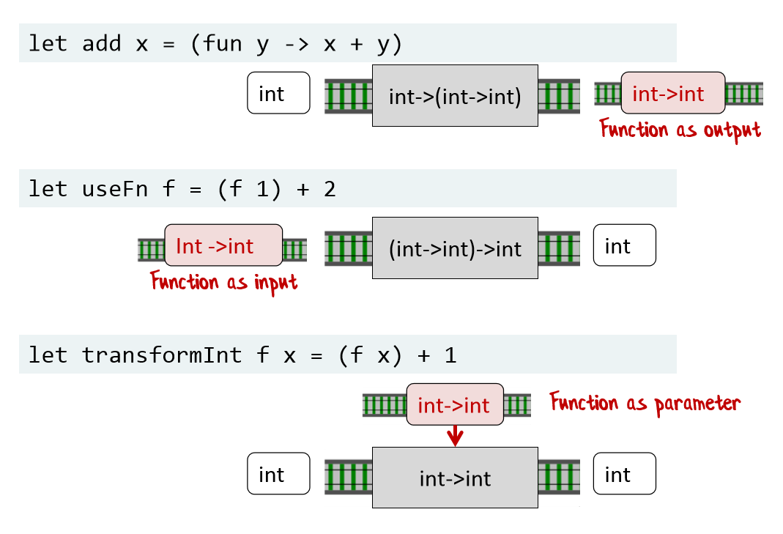
Functions as inputs and outputs!

Slide 21
Pattern:
Partial Application

Slide 22
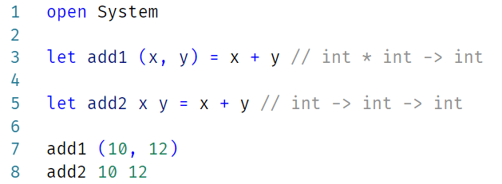
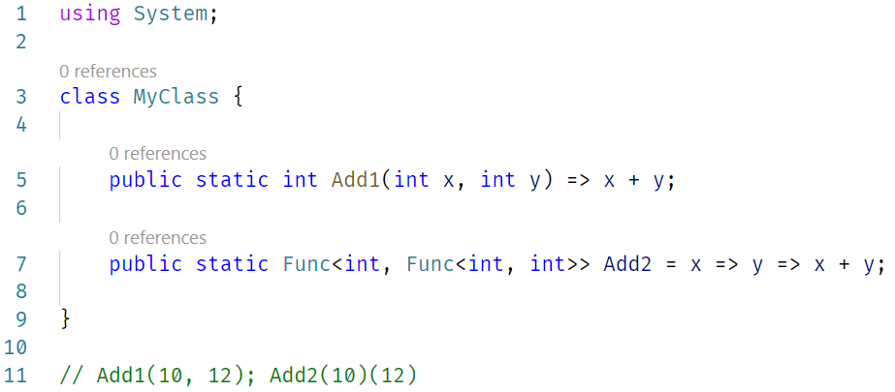

Slide 23
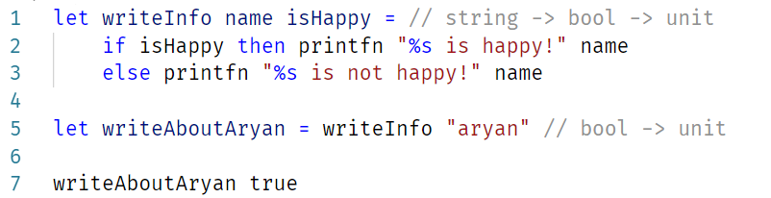
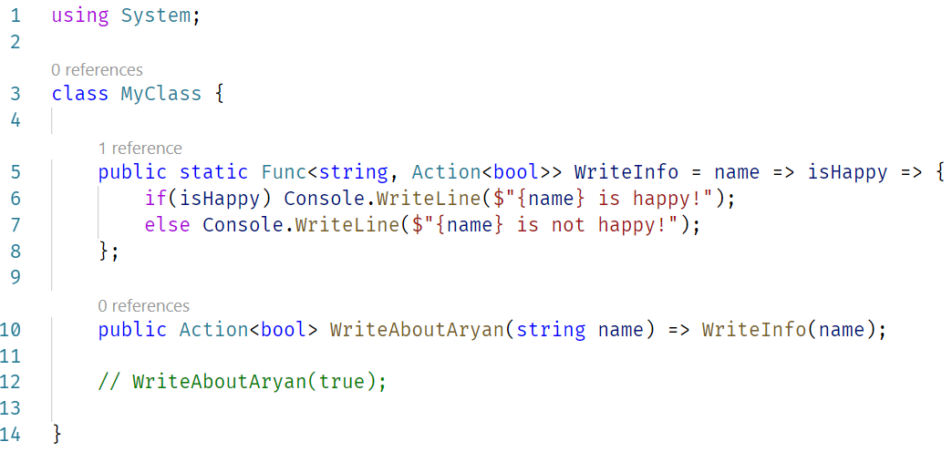

Slide 24
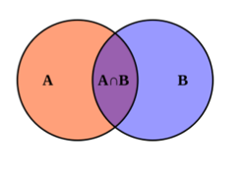
Core Principle:
Types are not classes

Slide 25
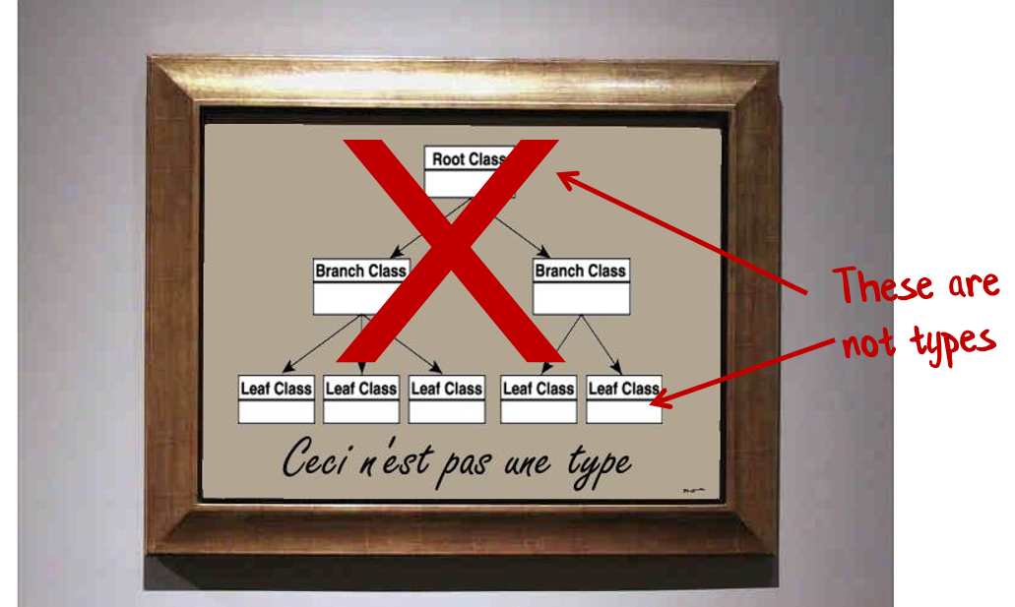
Types are not Classes!

Slide 26
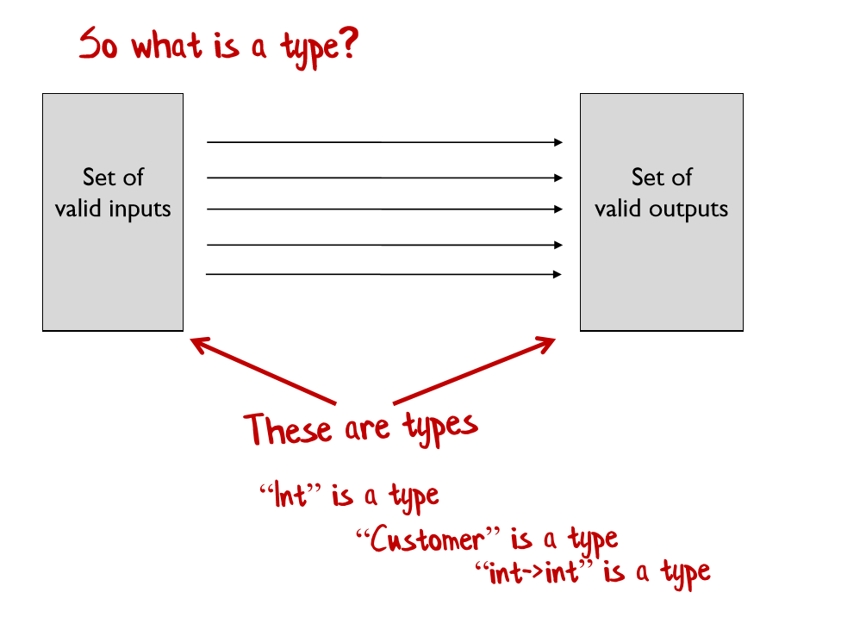
Types are not Classes!

Slide 27
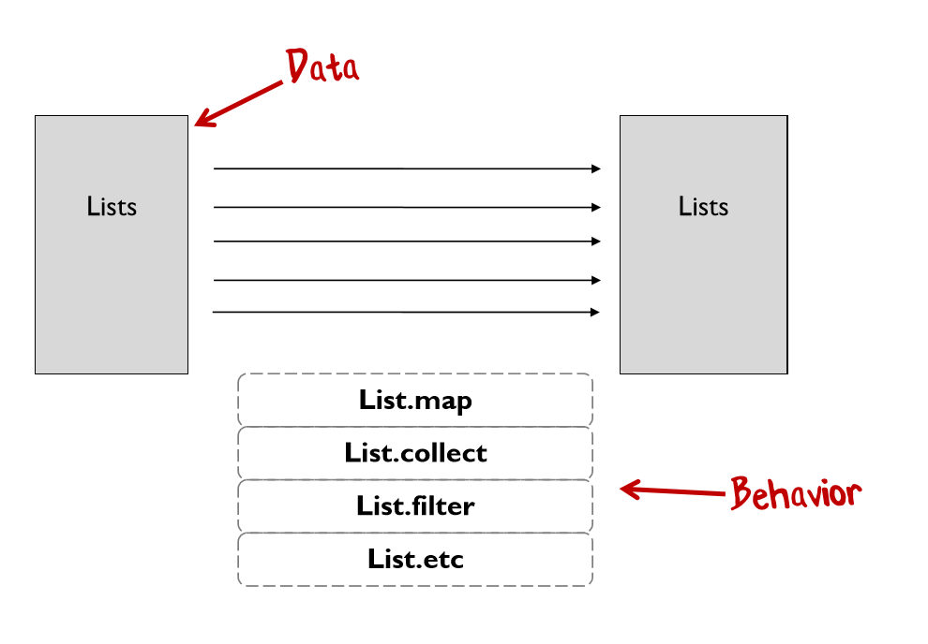
Types separate data from behaviour

Slide 28
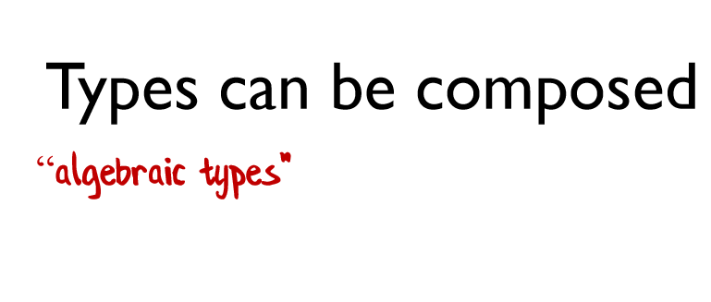
Algebraic Data Types (ADTs)

Slide 29
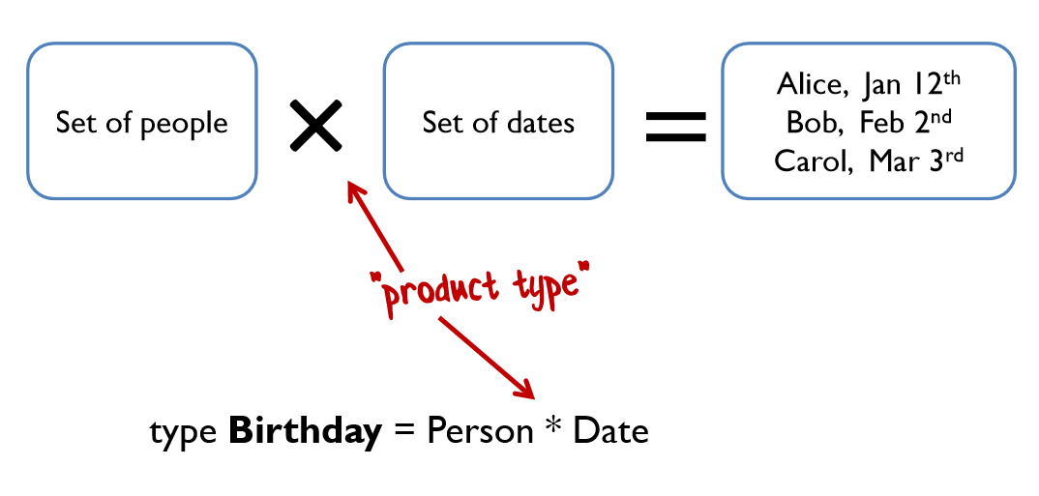
Algebraic Data Types (ADTs)

Slide 30
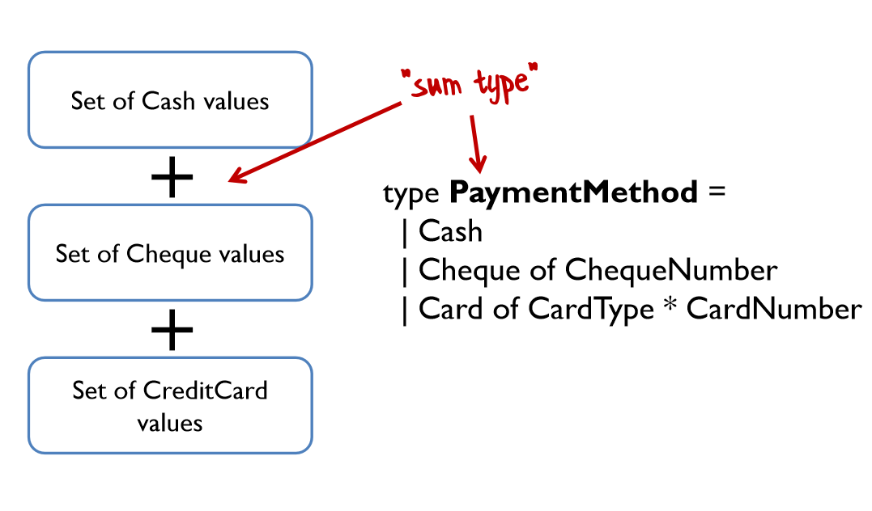
Algebraic Data Types (ADTs)

Slide 31
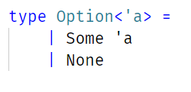
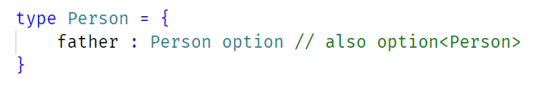
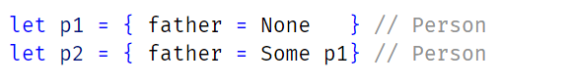
Algebraic Data Types (ADTs)
Haskell calls it “Maybe”
data Maybe a = Just a | Nothing

Slide 32
Tip:
Pattern Matching, Pattern Matching everywhere

Slide 33
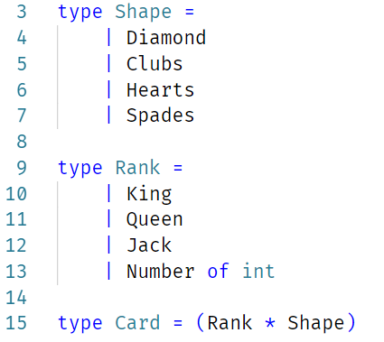
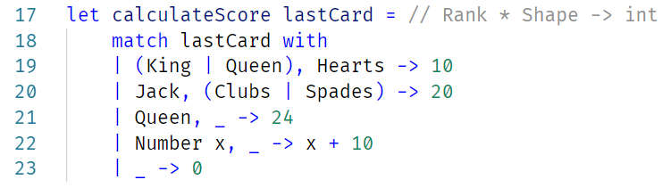

Slide 34
Design Principle:
Strive for totality

Slide 35
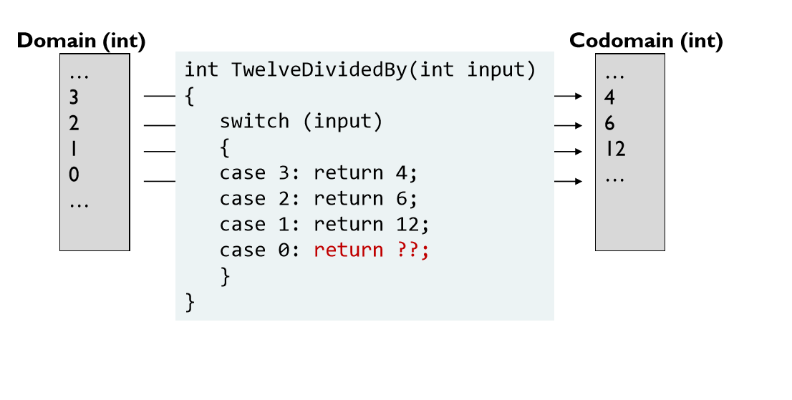
Totallity

Slide 36
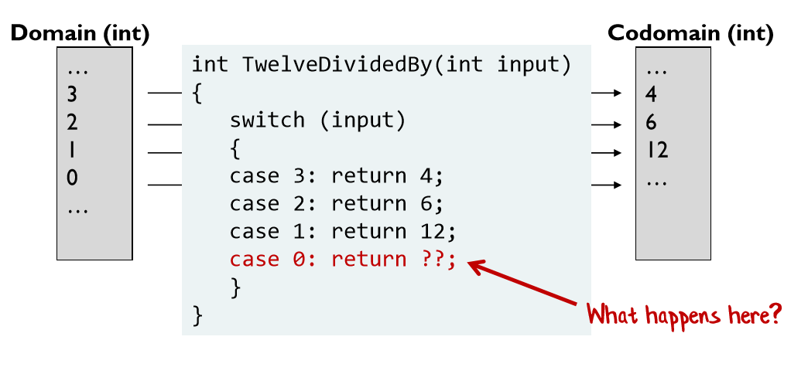
Totallity

Slide 37
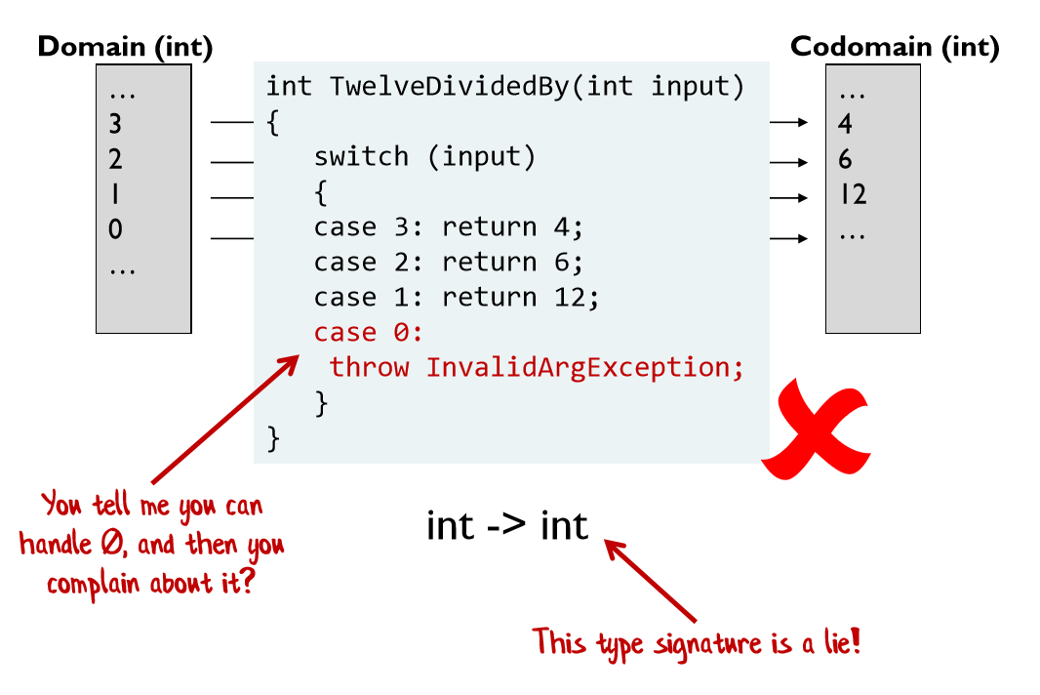
Totallity

Slide 38
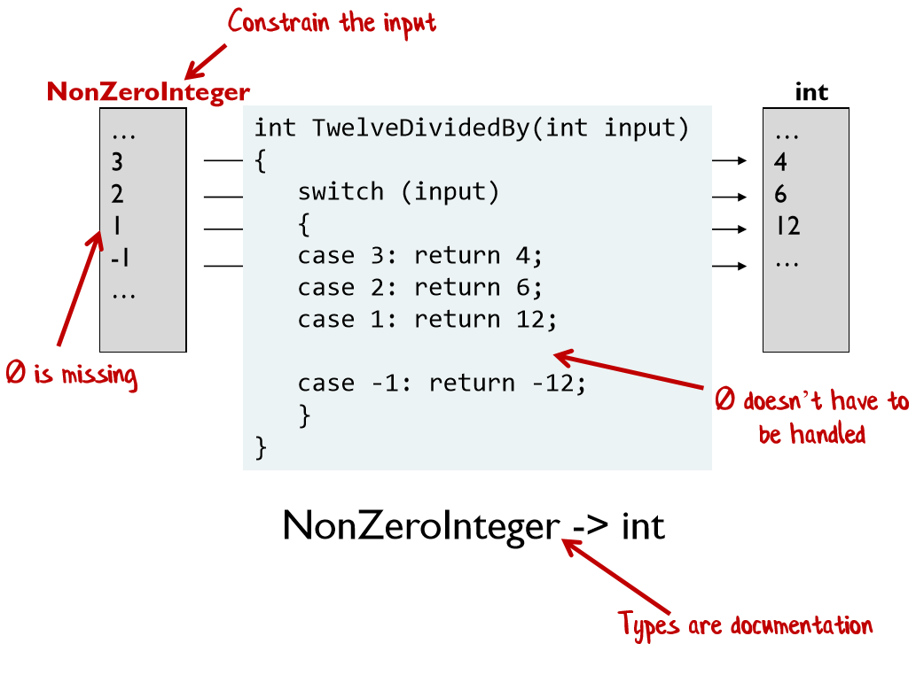
Totallity
Notes:
Refinement Types
Type Define Refine

Slide 39
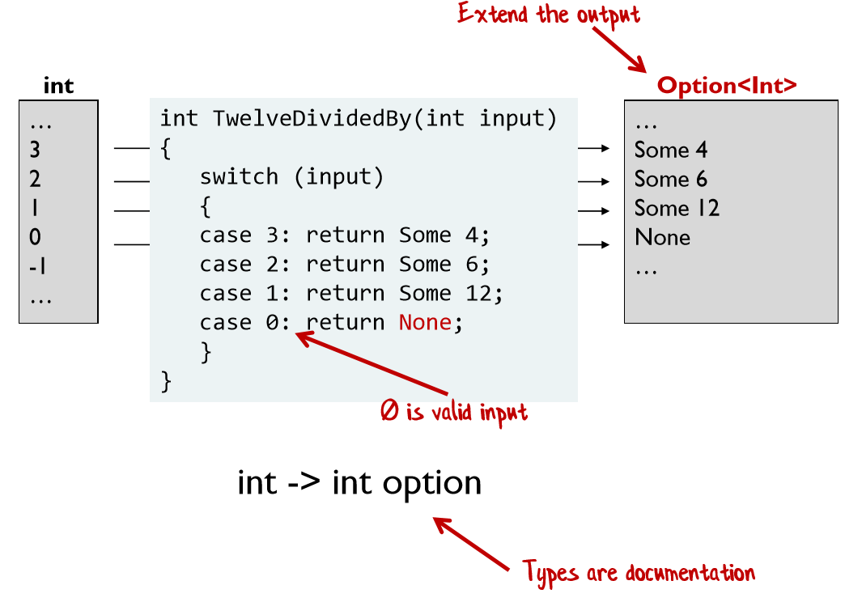
Totallity

Slide 40
Type Sig of Map(Select) in C# and F#
public static IEnumerable<TResult> Select<TSource,TResult>(this IEnumerable<TSource> source, Func<TSource, TResult> selector)
Types are documentation!
let map : (‘a -> ‘b) -> Seq<‘a> -> Seq<‘b>

Slide 41
Tip:
Use of custom operators where makes sense

Slide 42
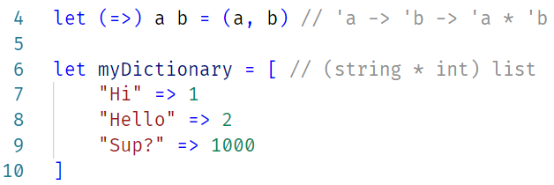
Custom Operators

Slide 43
Core Principle:
Composition Everywhere

Slide 44
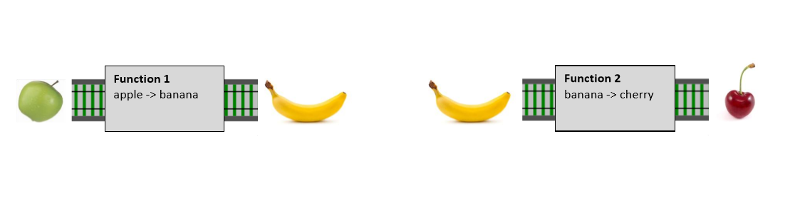
Function composition

Slide 45
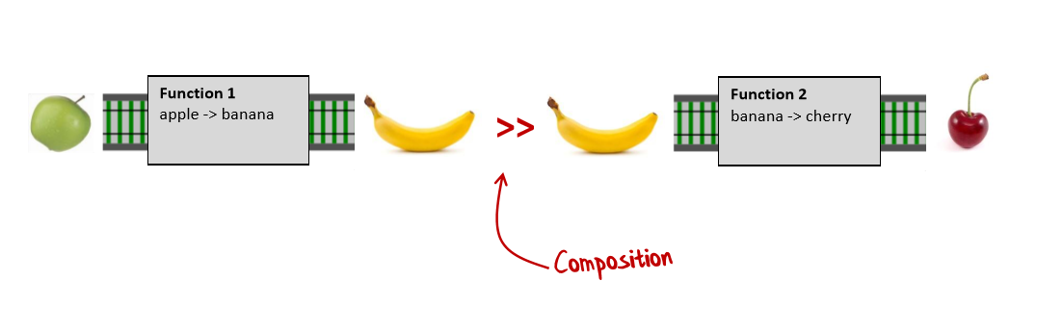
Function composition

Slide 46
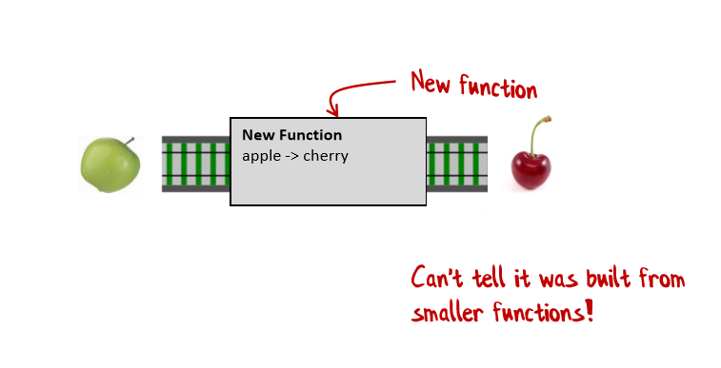
Function composition

Slide 47
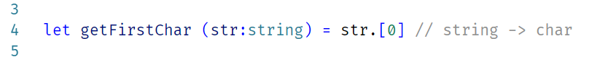
Function composition

Slide 48
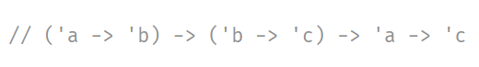
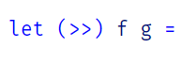
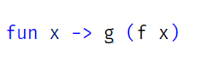
Can I define composition myself?

Slide 49

Design Paradigm:
Functions all the way down

Slide 50
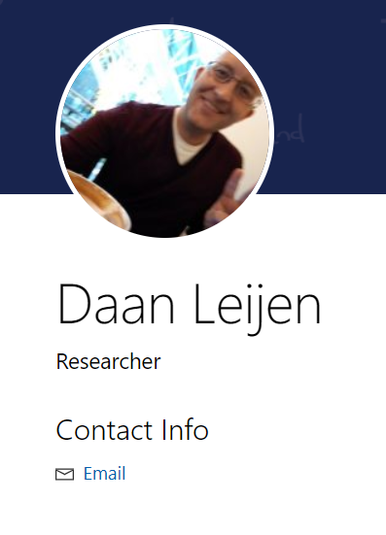
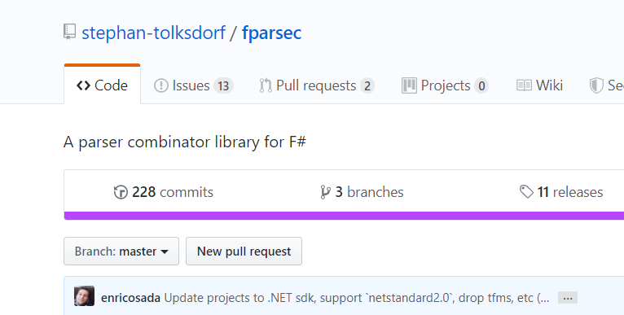
Example of Function all the way down

Slide 51
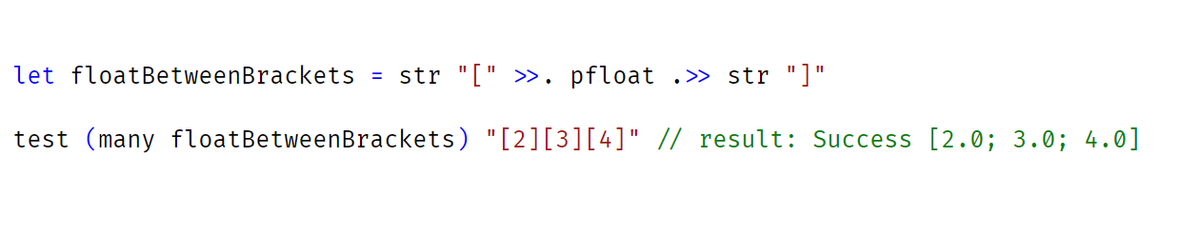
Functions all the way down - FParsec

Slide 52
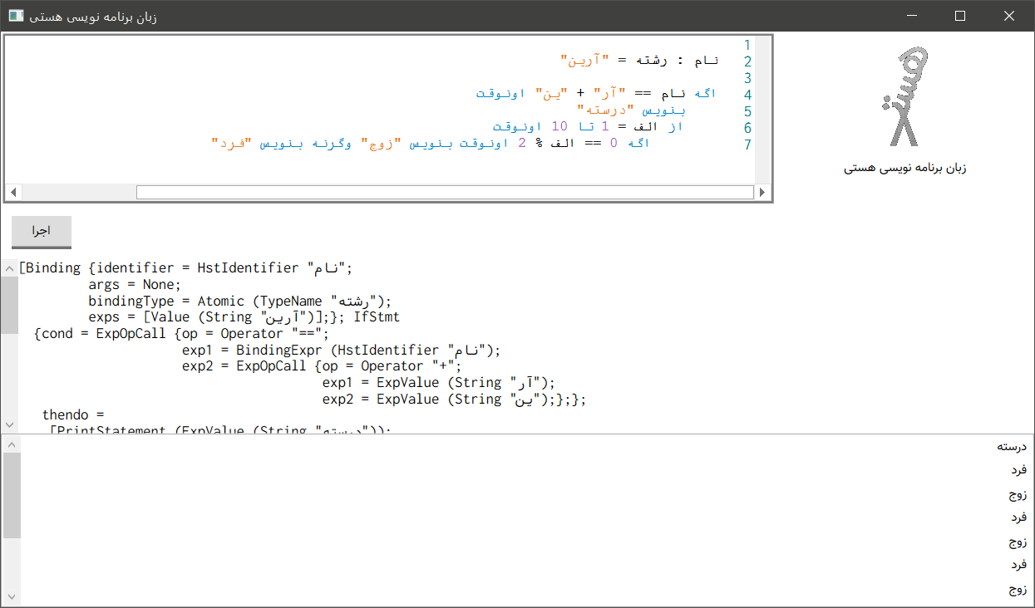

Slide 53
Functors, Applicatives and Monads
With Haskell examples
Notes:
I use Haskell but other FP langs can describe this too

Slide 54
Image Notations we need to understand slides

Slide 55
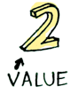
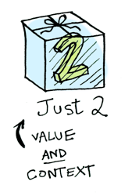
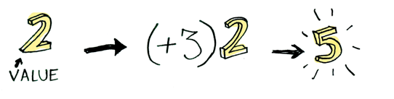
Notations
A value!
Applying a function
Value in context of ADTs

Slide 56
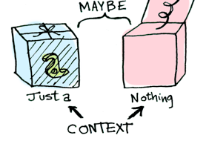
Notations
Notes:
when you apply a function to this value, you'll get different results depending on the context

Slide 57
Functors

Slide 58
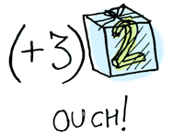
Problem
When a value is wrapped in a context, you can't apply a normal function to it:

Slide 59
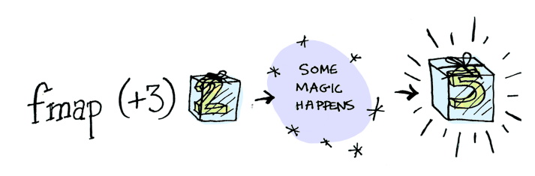
Solution
fmap is the solution! (infix operator: <$>)
fmap knows how to apply functions to values that are wrapped in a context
λ> fmap (+3) (Just 2)
Just 5

Slide 60
What is a functor really?
What is this magic?

Slide 61
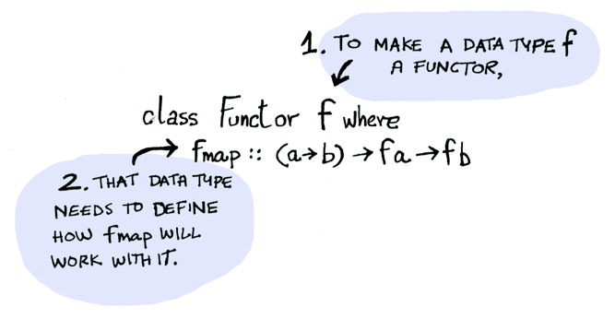
It’s like C# and Java interface,
But more powerful
Functor is a type class.

Slide 62
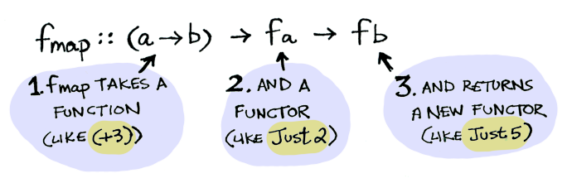

Slide 63
Nice! Show me the implementation

Slide 64


instance Functor Maybe where
fmap func (Just val) = Just (func val)
fmap func Nothing = Nothing

Slide 65
Main stream Languages
(you name it):
Haskell (and friends):
post = Post.find_by_id(1)
if post
return post.title
else
return nil
end
fmap (getPostTitle) (findPost 1)
-- Or –
getPostTitle <$> (findPost 1)

Slide 66


Slide 67
Applicatives

Slide 68

Problem
Value and Function are both in Context! Functors can’t help directly.

Slide 69

Solution
<*> is the solution!
λ> Just (+3) <*> Just 2
Just 5

Slide 70
Solution
Go for it!
(*) <$> Just 5 <*> Just 3

Slide 71
Monads

Slide 72
How to Learn about Monads?
Get a PhD in computer science.
Throw it away because you don't need it for this section!

Slide 73


Lets review Functors and Applicatives

Slide 74
Problem
Monads apply a function that returns a wrapped value to a wrapped value.
Good Ol’ Maybe is a Monad.

Slide 75

Problem
Suppose “half” is a function that only works on even numbers:
half x = if isEven x
then Just (x ÷ 2)
else Nothing

Slide 76

Problem
What if we use a wrapped value as input?

Slide 77

Solution
We need to use >>= operator to shove it into the function:
This is an unseen picture of >>=

Slide 78
λ> Just 3 >>= half
Nothing
λ> Just 4 >>= half
Just 2
λ> Nothing >>= half
Nothing

Slide 79
Nice! Show me the implementation

Slide 80

class Monad m where
(>>=) :: m a -> (a -> m b) -> m b

Slide 81

instance Monad Maybe where
Nothing >>= func = Nothing
Just val >>= func = func val

Slide 82

If you pass Nothing, it’s even simpler!

Slide 83

Thanks bro, can we have a review?
Me:

Slide 84

Functor: (a → b) → f a → f b
Anything that implements Functor Type Class. Apply a function to a wrapped value.
Applicative: f (a → b) → f a → f b
Anything that implements Applicative Type Class. apply a wrapped function to a wrapped value.
Monad: m a → (a → m b) → m b
Anything that implements Monad Type Class. apply a function with wrapped return value to a wrapped value.
Maybe is all of them!
Notes:
IO monads

Slide 85
Example
Read world example

Slide 86






Tones of PLs
Standard libs?
Project Everest
Notes:
Amazon Cloud on XenServer (virtualization platform)

Slide 87

C# Sum methon in Linq
(System.Enumerable)
let rec sum = function
| [] -> 0
| x::xs -> x + sum xs
OCaml/F# Sum function

Slide 88

C# imperative Quick Sort

Slide 89

OCaml/F# Quick Sort

Slide 90
Any questions?

Slide 91
References

Slide 92
References
Microsoft Research Podcast, Functional Programming Languages and the Pursuit of Laziness with Dr. Simon Peyton Jones
Functional Programming Design Patterns by Scott Wlaschin (fsharpforfunandprofit.com)
Why learn F#? And what is the advantage? By Aryan Ebrahimpour https://virgool.io/@0xaryan/learn-fsharp-for-fun-and-profit-ox5rxavm9tq3
Functors, Applicatives and Monads in Pictures (http://adit.io)

Slide 93

Thank you!
⭐ github.com/0xaryan/Presentation

